Slide 1


Innovative Navigation System for University Websites
This presentation showcases a pioneering navigation system designed for university websites to enhance student access to essential academic resources. By optimizing the user experience, it enables students to swiftly find crucial information, ultimately promoting greater academic engagement and success.

Slide 2

Current Navigation Challenges
University websites face significant navigation challenges, affecting students' ability to access essential information. Complexity in existing systems often leaves users feeling lost, with a reported average search time of 10 minutes for basic details. Moreover, inconsistencies across department navigation styles create confusion, further diminishing user satisfaction. Lastly, inadequate mobile optimization contributes to frustrating experiences for users reliant on mobile devices for information.
Complexity of Existing Systems
Outdated layouts complicate information access, causing frustration.
Inconsistent User Experience
Varying navigation styles confuse users and lower satisfaction.
Limited Mobile Optimization
Poor mobile design frustrates users accessing sites via smartphones.

Slide 3



Proposed Navigation Features
Interactive Resource Map
2
Visual layout guiding students to various resources around campus.
Intuitive Search Functionality
1
A prominent search bar for typing keywords related to needs.
3
Personalized Dashboard
A customizable dashboard displaying resources tailored to user preferences.

Slide 4

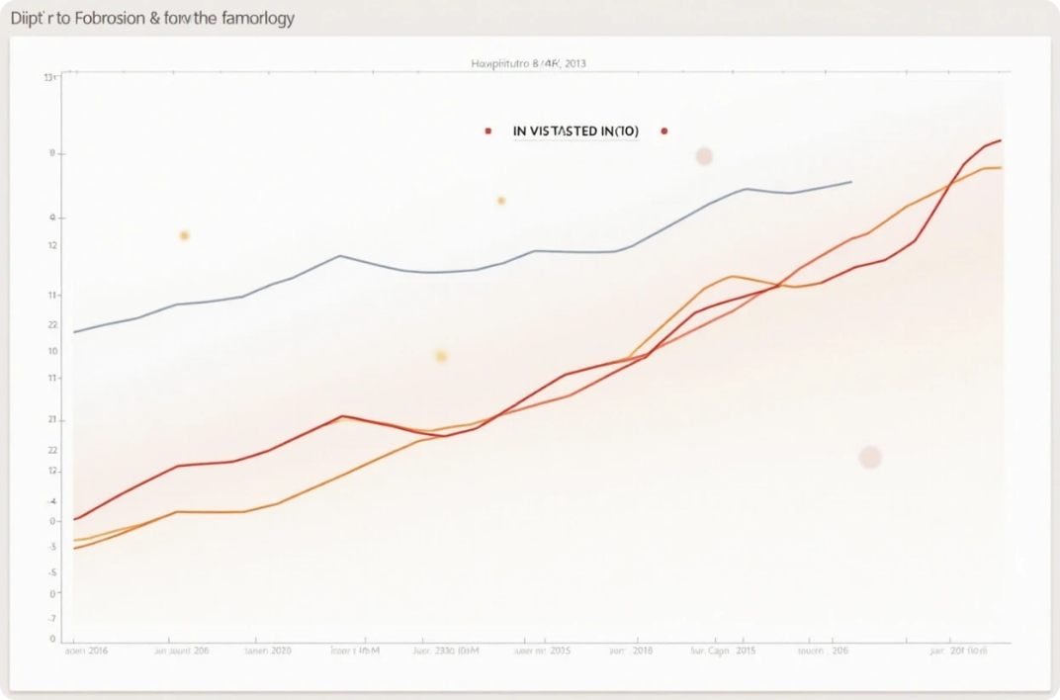

User Testing and Feedback
Involving Student Feedback
A/B Testing for Optimization
User Training and Support
Prior to launching the new navigation system, it's essential to conduct usability testing with a diverse group of students.
Implement A/B testing to assess how different navigation models perform with live user groups.
Creating user guides and offering orientation sessions can assist students in adapting to the new navigation system.

Slide 5


Enhancing Overall User Experience
Streamlined Access to Resources
Visual Consistency and Branding
Regular Updates and Maintenance
The proposed navigation system should drastically reduce the time required for students to locate academic resources.
A cohesive visual identity enhances recognition and usability while instilling a sense of unity across the university's online presence.
An ongoing commitment to maintaining and updating the navigation system will keep the content relevant.

Slide 6




Conclusion and Future Directions
2
Continuous Improvement Strategy
Ongoing user feedback ensures the system adapts to changing behaviors.
User-Centric Design
Focusing on user needs will guide effective navigation system development.
1
Collaboration Across Departments
Coordination between stakeholders fosters understanding of student priorities.
3

